Slide 1
Randomized Algorithms CS648
Lecture 20
Randomized Incremental Construction
(part II)

Slide 2
Randomized Incremental Construction

Slide 3
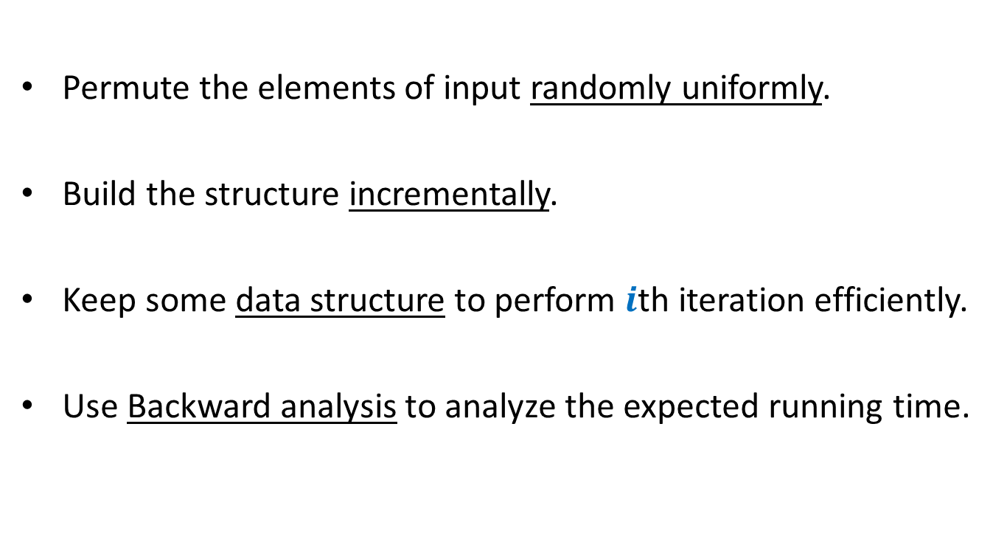
Randomized Incremental Construction
Permute the elements of input randomly uniformly.
Build the structure incrementally.
Keep some data structure to perform $i$th iteration efficiently.
Use Backward analysis to analyze the expected running time.

Slide 4
Randomized Incremental Construction
Convex Hull of a set of points
Trapezoidal decomposition of a set of segments.
Convex polytope of a set of half-planes
Smallest sphere enclosing a set of points.
Linear programming in finite dimensions.

Slide 5

Trapezoidal decomposition
Report the segment just above a query point.
O($log n$) time

Slide 6


Trapezoidal decomposition
O($(n+m) log n$) time
O($m+n log n$) time

Slide 7
problem 3 Convex hull of Points

Slide 8

Convex hull of Points
Problem definition:
Given $n$ points in a plane, compute a convex polygon of smallest area that encloses all the points.

Slide 9
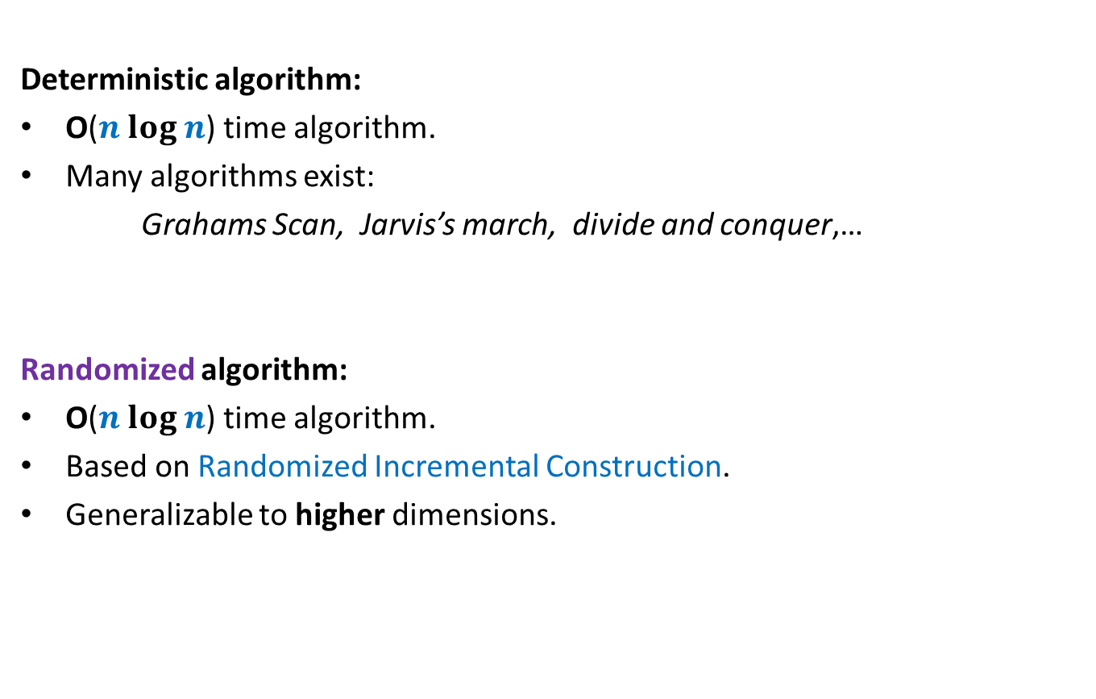
Convex hull of Points
Deterministic algorithm:
O($n log n$) time algorithm.
Many algorithms exist:
Grahams Scan, Jarvis’s march, divide and conquer,…
Randomized algorithm:
O($n log n$) time algorithm.
Based on Randomized Incremental Construction.
Generalizable to higher dimensions.

Slide 10
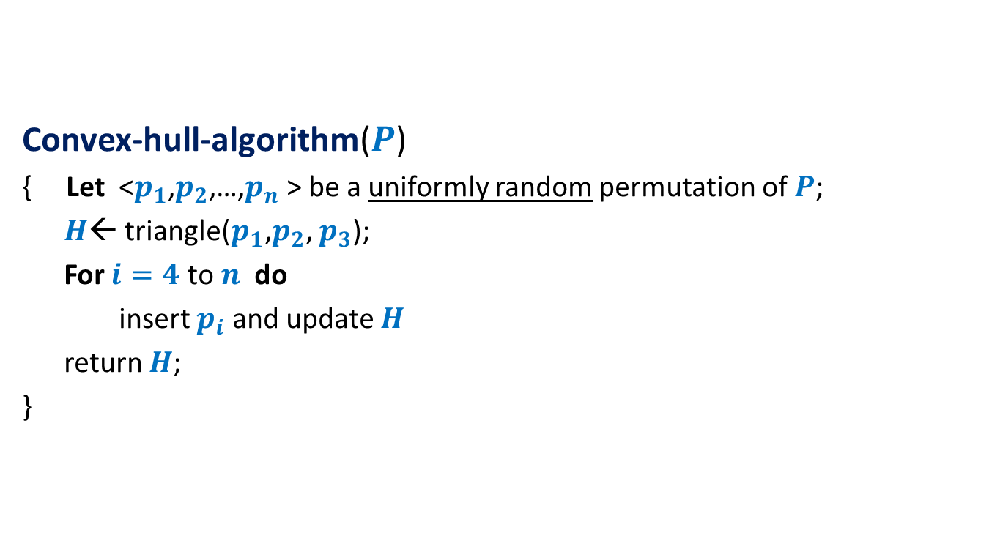
Randomized algorithm for convex hull
Convex-hull-algorithm($P$)
{ Let <$p_{1}$,$p_{2}$,…,$p_{n}$ > be a uniformly random permutation of $P$;
$H$← triangle($p_{1}$,$p_{2}$, $p_{3}$);
For $i=4$ to $n$ do
insert $p_{i}$ and update $H$
return $H$;
}

Slide 11





A simple exercise from geometry
Exercise: Given a line L and two points p and q,
determine whether the points lie on the same/different sides of L.
L
p
$$\left(x_{1},y_{1}\right)$$
q
$$\left(x_{2},y_{2}\right)$$
q
$$\left(x_{1},{mx}_{1}+c\right)$$
$$y=mx+c$$
$$\left(x_{2},{mx}_{2}+c\right)$$

Slide 13

















Conflict graph : a powerful data structure
$$c_{2}$$
$n−i$points
cones
$$c_{1}$$
$$c_{1}$$
$$c_{8}$$
$$c_{3}$$
$$c_{2}$$
$$c_{3}$$
$$c_{4}$$
$$c_{5}$$
$$c_{7}$$
$$c_{4}$$
$$c_{6}$$
$$c_{7}$$
$$c_{8}$$
$$c_{5}$$
$$c_{6}$$

Slide 15




Before entering the for loop
$n−3$points
cones
$$c_{1}$$
$$c_{1}$$
$$c_{2}$$
$$c_{2}$$
$$c_{3}$$
$$c_{3}$$

Slide 16

Inserting $i$th POINt

Slide 17


$i$th iteration
$$c_{1}$$
$$c_{2}$$
$$c_{8}$$
$$c_{3}$$
$$c_{7}$$
$$c_{4}$$
$$c_{5}$$
$$c_{6}$$

Slide 18

$i$th iteration
$$c_{2}$$
$n−i+1$points
cones
$$c_{1}$$
$$c_{1}$$
$$c_{8}$$
$$c_{3}$$
$$c_{2}$$
$$c_{3}$$
$$c_{4}$$
$$c_{5}$$
$$c_{7}$$
$$c_{4}$$
$$c_{6}$$
$$c_{7}$$
$$c_{8}$$
$$c_{5}$$
$$c_{6}$$

Slide 19



$i$th iteration
$$c_{2}$$
$n−i+1$points
cones
$$c_{1}$$
$$c_{1}$$
$$c_{8}$$
$$c_{3}$$
$$c_{2}$$
$$p_{i}$$
$$c_{3}$$
$$p_{i}$$
$$c_{4}$$
$$p_{i}$$
$$c_{5}$$
$$c_{7}$$
$$c_{4}$$
$$c_{6}$$
$$c_{7}$$
$$c_{8}$$
$$c_{5}$$
$$c_{6}$$

Slide 20
$i$th iteration
$$c_{2}$$
$n−i+1$points
cones
$$c_{1}$$
$$c_{1}$$
$$c_{8}$$
$$c_{3}$$
$$c_{2}$$
$$c_{3}$$
$$c_{4}$$
$$c_{5}$$
$$c_{7}$$
$$c_{4}$$
$$c_{6}$$
$$c_{7}$$
$$c_{8}$$
$$c_{5}$$
$$c_{6}$$

Slide 21
$i$th iteration
$$c_{2}$$
$n−i$points
cones
$$c_{1}$$
$$c_{1}$$
$$c_{8}$$
$$c_{3}$$
$$c_{2}$$
$$c_{3}$$
$$c_{4}$$
$$c_{5}$$
$$c_{7}$$
$$c_{4}$$
$$c_{6}$$
$$c_{7}$$
$$c_{8}$$
$$c_{5}$$
$$c_{6}$$

Slide 22
$i$th iteration
$$c_{2}$$
$n−i$points
cones
$$c_{1}$$
$$c_{1}$$
$$c_{8}$$
$$c_{3}$$
$$c_{2}$$
$$c_{3}$$
$$c_{4}$$
$$c_{5}$$
$$c_{7}$$
$$c_{4}$$
$$c_{6}$$
$$c_{7}$$
$$c_{8}$$
$$c_{5}$$
$$c_{6}$$

Slide 23
$i$th iteration
$$c_{2}$$
$n−i$points
cones
$$c_{1}$$
$$c_{1}$$
$$c_{8}$$
$$c_{3}$$
$$c_{2}$$
$$c_{3}$$
$$c_{4}$$
$$c_{5}$$
$$c_{7}$$
$$c_{4}$$
$$c_{6}$$
$$c_{7}$$
$$c_{8}$$
$$c_{5}$$
$$c_{6}$$

Slide 24
$i$th iteration
$$c_{2}$$
$n−i$points
cones
$$c_{1}$$
$$c_{1}$$
$$c_{8}$$
$$c_{3}$$
$$c_{2}$$
$$c_{3}$$
$$c_{4}$$
$$c_{5}$$
$$c_{7}$$
$$c_{4}$$
$$c_{6}$$
$$c_{7}$$
$$c_{8}$$
$$c_{5}$$
$$c_{6}$$

Slide 25


$i$th iteration
$$c_{2}$$
$n−i$points
cones
$$c_{1}$$
$$c_{1}$$
$$c_{8}$$
$$c_{3}$$
$$c′$$
$$c_{2}$$
$$c_{3}$$
$$c_{4}$$
$$c_{5}$$
$$c_{7}$$
$$c_{4}$$
$$c_{6}$$
$$c"$$
$$c_{7}$$
$$c_{8}$$
$$c_{5}$$
$$c_{6}$$

Slide 26




$i$th iteration
$n−i$points
cones
$$c_{1}$$
$$c_{1}$$
$$c_{8}$$
$$c′$$
$$c′$$
$$c"$$
$$c_{7}$$
$$c_{6}$$
$$c"$$
$$c_{7}$$
$$c_{8}$$
$$c_{6}$$

Slide 27
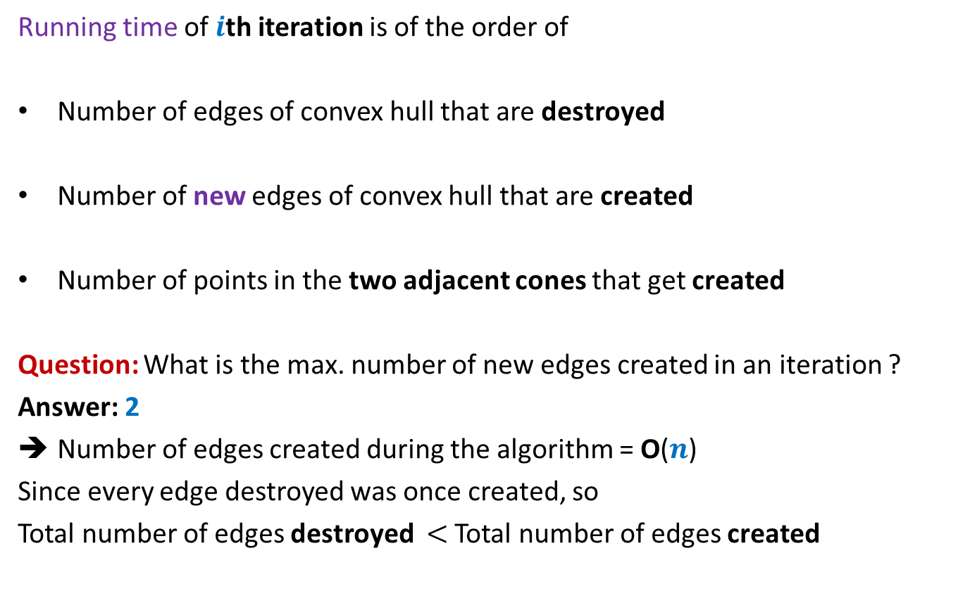


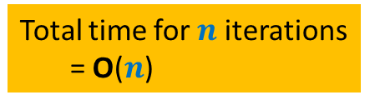
Running time of $i$th iteration
Running time of $i$th iteration is of the order of
Number of edges of convex hull that are destroyed
Number of new edges of convex hull that are created
Number of points in the two adjacent cones that get created
Question: What is the max. number of new edges created in an iteration ?
Answer: 2
Number of edges created during the algorithm = O($n$)
Since every edge destroyed was once created, so
Total number of edges destroyed $<$ Total number of edges created
Total time for $n$iterations
= O($n$)
$$X_{i}$$

Slide 28



Backward analysis of $i$th iteration
$a$ : a subset of $i$ points from $P$.
$𝓔_{a}$: first $i$ points of $P$ are some permutation of $a$
${E[X}_{i} \left|{ 𝓔}_{a}\right)$ = ??
Convex hull
at the end of $i$th iteration

Slide 29









Backward analysis of $i$th iteration
$a$ : a subset of $i$ points from $P$.
$𝓔_{a}$: first $i$ points of $P$ are some permutation of $a$
${E[X}_{i} \left|{ 𝓔}_{a}\right)$ = ??
$$c_{1}$$
$$c_{2}$$
$$c_{8}$$
$$p_{1}′$$
$$c_{3}$$
$$p_{8}′$$
$$p_{2}′$$
$$p_{7}′$$
$$p_{3}′$$
$$c_{7}$$
$$c_{4}$$
$$p_{4}′$$
$$p_{6}′$$
$$p_{5}′$$
$$c_{5}$$
$$c_{6}$$

Slide 30





Backward analysis of $i$th iteration
$a$ : a subset of $i$ points from $P$.
$𝓔_{a}$: first $i$ points of $P$ are some permutation of $a$
${E[X}_{i} \left|{ 𝓔}_{a}\right)$ = ??
$$c_{1}$$
$$c_{2}$$
$$c_{8}$$
$$p_{1}′$$
$$c_{3}$$
$$p_{8}′$$
$$p_{2}′$$
$$p_{7}′$$
$$n_{1}+n_{2}$$
$$p_{3}′$$
$$c_{4}$$
$$n_{2}+n_{3}$$
$$c_{7}$$
$$n_{3}+n_{4}$$
$$p_{4}′$$
$$p_{6}′$$
$$n_{4}+n_{5}$$
$$p_{5}′$$
$$c_{5}$$
$$c_{6}$$

Slide 31






Backward analysis of $i$th iteration
$a$ : a subset of $i$ points from $P$.
$𝓔_{a}$: first $i$ points of $P$ are some permutation of $a$
${E[X}_{i} \left|{ 𝓔}_{a}\right)$ = ??
$$c_{1}$$
$$c_{2}$$
$$c_{8}$$
$$p_{1}′$$
$$c_{3}$$
$$p_{8}′$$
$$p_{2}′$$
$$n_{1}+n_{2}$$
+
$$\frac{1}{i}$$
$$p_{7}′$$
$$p_{3}′$$
+
$$n_{2}+n_{3}$$
+
$$\frac{1}{i}$$
$$c_{7}$$
$$c_{4}$$
+
$$n_{3}+n_{4}$$
+
$$\frac{1}{i}$$
$$p_{4}′$$
+
$$p_{6}′$$
$$n_{4}+n_{5}$$
+
$$\frac{1}{i}$$
$$p_{5}′$$
$$c_{5}$$
+
$$c_{6}$$
+
$$\frac{1}{i}$$
$$n_{7}+n_{8}$$
+
$$n_{8}+n_{1}$$
+
$$\frac{1}{i}$$

Slide 32
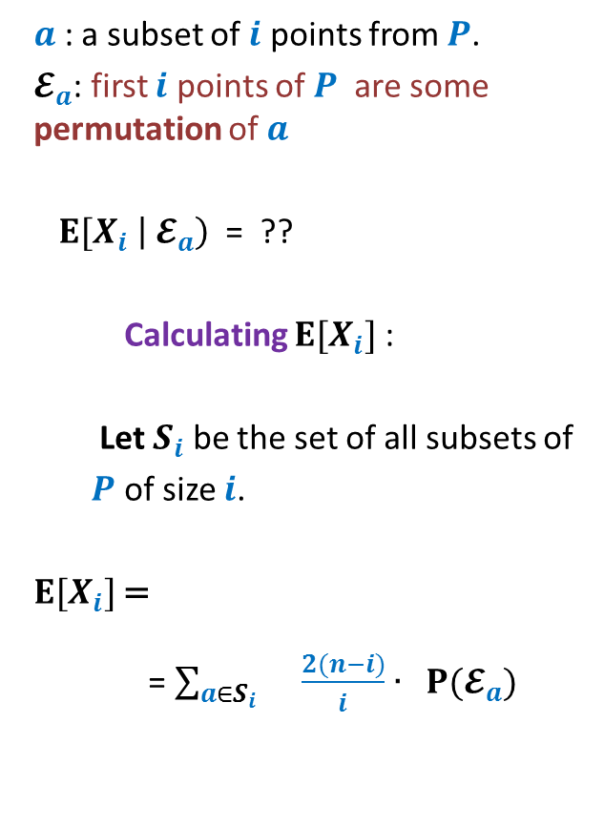

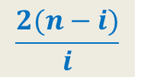
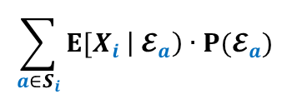
Backward analysis of $i$th iteration
$a$ : a subset of $i$ points from $P$.
$𝓔_{a}$: first $i$ points of $P$ are some permutation of $a$
${E[X}_{i} \left|{ 𝓔}_{a}\right)$ = ??
Calculating ${E[X}_{i}]$ :
Let $S_{i}$ be the set of all subsets of
$P$ of size $i$.
${E[X}_{i}]$=
= $\sum_{a∈S_{i} }{\frac{2(n−i)}{i}∙ P(𝓔_{a}) }$
$$c_{1}$$
$$c_{2}$$
$$c_{8}$$
$$p_{1}′$$
$$c_{3}$$
$$p_{8}′$$
$$\frac{2(n−i)}{i}$$
$$p_{2}′$$
$$p_{7}′$$
$$p_{3}′$$
$$c_{7}$$
$$c_{4}$$
$$p_{4}′$$
$$p_{6}′$$
$$\sum_{a∈S_{i}}{{E[X}_{i} \left|{ 𝓔}_{a}\right)∙P(𝓔_{a}) }$$
$$p_{5}′$$
$$c_{5}$$
$$c_{6}$$
= $\frac{2(n−i)}{i}$

Slide 33
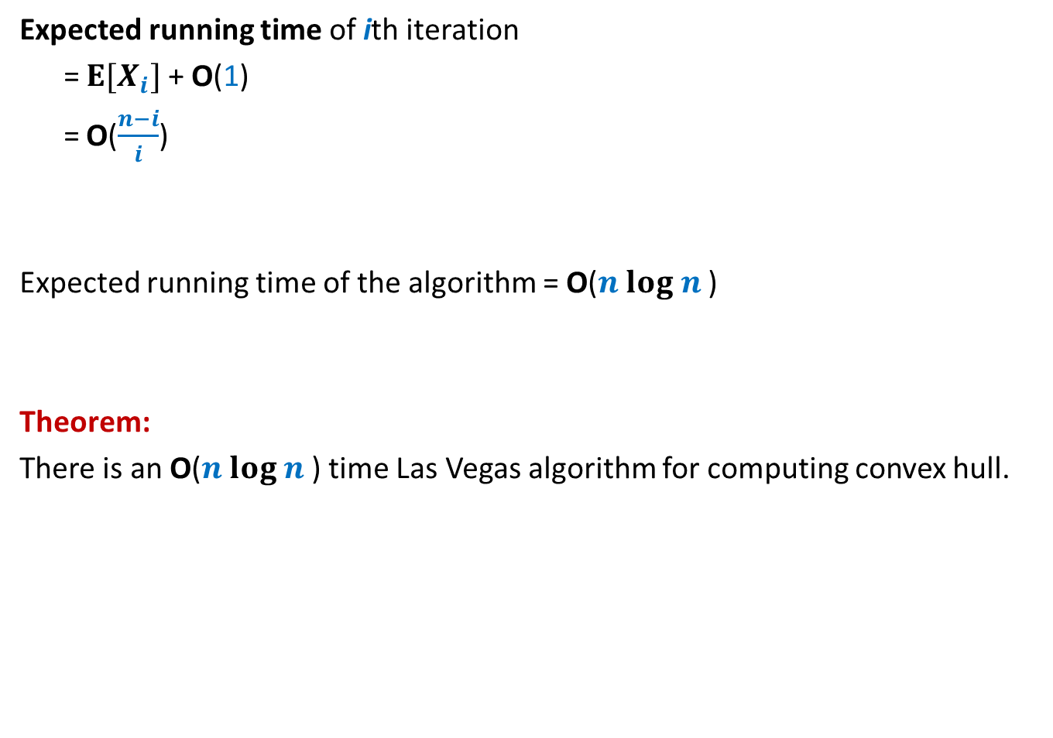
Running time of the algorithm
Expected running time of ith iteration
= ${E[X}_{i}]$ + O(1)
= O($\frac{n−i}{i}$)
Expected running time of the algorithm = O($n log n$)
Theorem:
There is an O($n log n$) time Las Vegas algorithm for computing convex hull.

Slide 34
USING Backward analysis for Miscellaneous Applications

Slide 35
problem 1 SMALLEST Enclosing circle

Slide 36
Smallest Enclosing Circle

Slide 37

Smallest Enclosing Circle
Question:
Suppose we sample $k$ points randomly uniformly from a set of $n$points,
what is the expected no. of points that remain outside the smallest circle
enclosing the sample?
For $k$= $\frac{n}{2}$, the answer is $<10$

Slide 38
problem 2 smallest length interval

Slide 39
Sampling points from a unit interval
Question: Suppose we select $k$points randomly uniformly from interval [0,1],
what is expected length of the smallest sub-interval ?
for $k=1$, it is ??
for $k=2$, it is ??
General solution : ??
This bound can be derived using two methods.
relationship between uniform distribution and exponential distribution.
Backward analysis.
$\frac{1}{4}$
$\frac{1}{9}$
$$\frac{1}{{\left(k+1\right)}^{2}}$$
0
1

Slide 40
problem 3 Minimum spanning tree

Slide 41
Minimum spanning tree
16
d
17
9
h
v
4
2
5
x
19
6
11
y
22
3
3
c
12
a
18
1
10
u
15
b
7
13

Slide 42
Minimum spanning tree
16
d
17
9
h
v
4
2
5
x
19
6
11
y
22
3
3
c
12
a
18
1
10
u
15
b
7
13

Slide 43

Light Edge
16
d
17
9
Definition: Let $a⊂E$.
An edge $e∈E\backslash a$ is said to be light with respect to $a$ if
Question:
If $a⊂_{r}E$ and |$a$|= $k$,
how many edges from $E\backslash a$ are light with respect to $a$ on expectation ?
Answer: ??
h
v
4
2
5
x
19
6
11
y
22
3
3
c
12
a
18
1
10
u
15
b
7
13
MST($\{e\}∪a$) $≠$ MST($a$)
$$<\frac{n}{k}(m−k)$$

Slide 44

Smallest Enclosing Circle
Let $C$ be smallest enclosing circle for set $P$ of point.
Facts from high school geometry
$C$ is defined by 2 or 3 points lying on its boundary.

Slide 45
Smallest Enclosing Circle
Let $C$ be smallest enclosing circle for set $P$ of point.
Facts from high school geometry
$C$ is defined by 2 or 3 points lying on its boundary.
Not the smallest enclosing circle
Since the defining points form
an obtuse triangle.

Slide 46
Smallest Enclosing Circle
Let $C$ be smallest enclosing circle for set $P$ of point.
Facts from high school geometry
$C$ is defined by 2 or 3 points lying on its boundary.
This is the smallest enclosing
Circle since the defining points
form an acute angle triangle.

Slide 47

Smallest Enclosing Circle
Let $C$ be smallest enclosing circle for set $P$ of point.
Facts from high school geometry
$C$ is defined by 2 or 3 points lying on its boundary.
Lemma 1: If $p$ lies outside $C$,
$p$ must be one of the defining point of smallest enclosing circle of $P∪\{p\}$

Slide 48
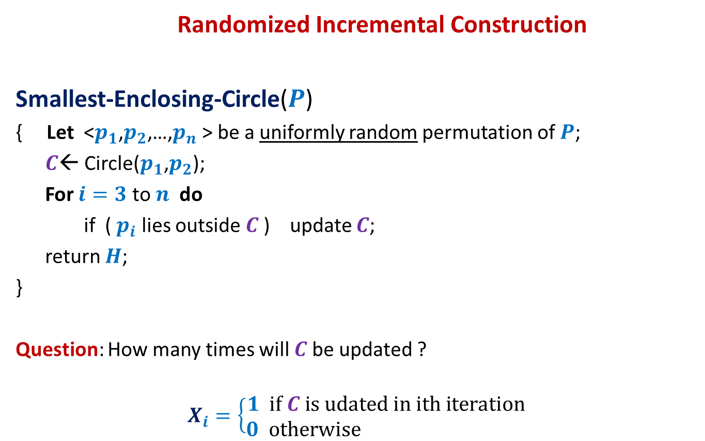
Smallest Enclosing Circle
Randomized Incremental Construction
Smallest-Enclosing-Circle($P$)
{ Let <$p_{1}$,$p_{2}$,…,$p_{n}$ > be a uniformly random permutation of $P$;
$C$← Circle($p_{1}$,$p_{2}$);
For $i=3$ to $n$ do
if ( $p_{i}$ lies outside $C$) update $C$;
return $H$;
}
Question: How many times will $C$be updated ?
$$X_{i}=\left\{\begin{aligned}1 if C is udated in ith iteration \\ 0 otherwise \end{aligned}\right.$$
?

Slide 49


Smallest Enclosing Circle
Question: What is P[$X_{i}=1$] ?
Smallest Enclosing Circle
at the end of $i$th iteration

Slide 50
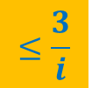

Smallest Enclosing Circle
$$≤\frac{3}{i}$$
Using Lemma 1
Question: What is P[$X_{i}=1$] ?
Use it to solve the given problem.

Slide 51
problem 3 Minimum spanning tree

Slide 52
Minimum spanning tree
16
d
17
9
h
v
4
2
5
x
19
6
11
y
22
3
3
c
12
a
18
1
10
u
15
b
7
13

Slide 53
Minimum spanning tree
16
d
17
9
Algorithms:
Prim’s algorithm
Kruskal’s algorithm
Boruvka’s algorithm
h
v
4
2
5
x
19
6
11
y
22
3
3
c
12
a
18
1
10
u
15
b
7
13
Less known but it is the first algorithm for MST

Slide 54
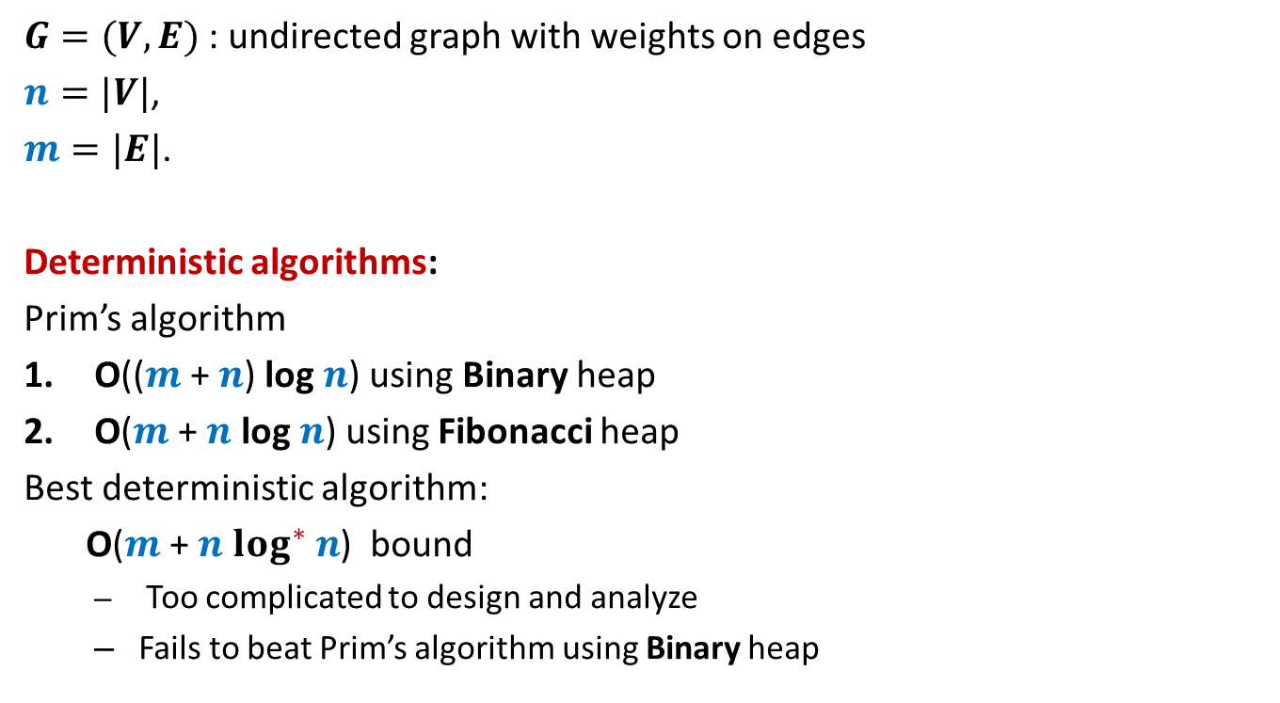
Minimum spanning tree
$G=(V,E)$ : undirected graph with weights on edges
$n=|V|$,
$m=|E|$.
Deterministic algorithms:
Prim’s algorithm
O(($m$ + $n$) log $n$) using Binary heap
O($m$ + $n$ log $n$) using Fibonacci heap
Best deterministic algorithm:
O($m$ + $n$ $\log^{∗} n$) bound
Too complicated to design and analyze
Fails to beat Prim’s algorithm using Binary heap

Slide 55
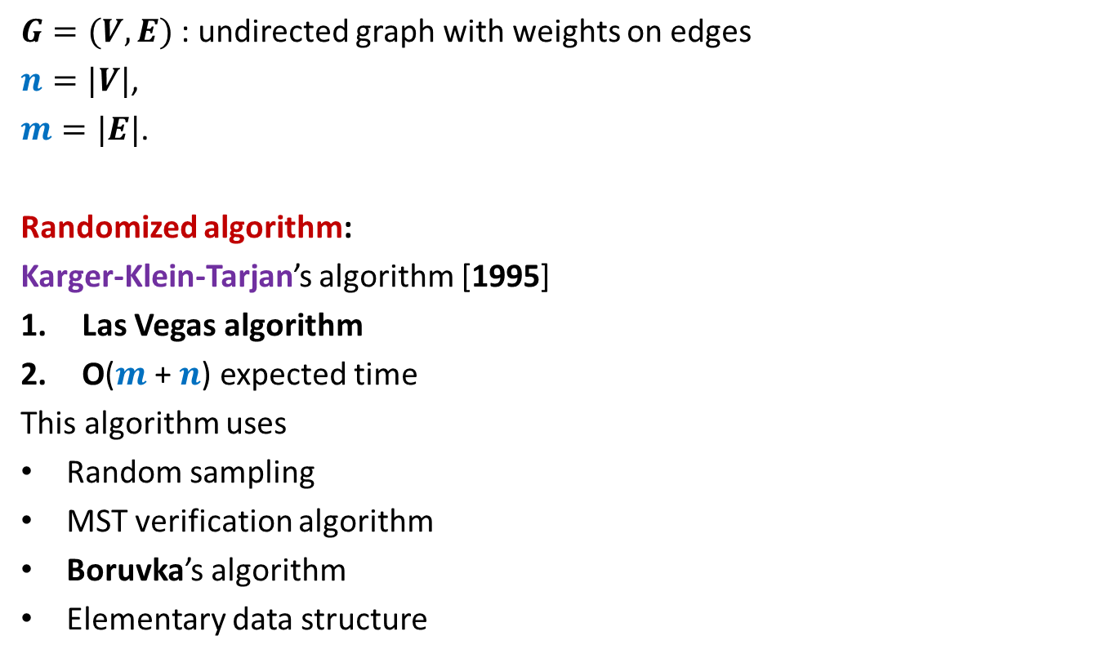
Minimum spanning tree
$G=(V,E)$ : undirected graph with weights on edges
$n=|V|$,
$m=|E|$.
Randomized algorithm:
Karger-Klein-Tarjan’s algorithm [1995]
Las Vegas algorithm
O($m$ + $n$) expected time
This algorithm uses
Random sampling
MST verification algorithm
Boruvka’s algorithm
Elementary data structure
We will discuss this milestone result in the next class.

